Slide 1
Resource type in Cloud
Compute- Where Memory and CPU is needed
Storage- Where you want to store somethings
Networking- Providing connectopy
Database- an organized collection of structured information, or data, typically stored electronically in a computer system.

Slide 2
Spring pet clinic application
Requirement is-
1) git
2) Java17

Slide 3
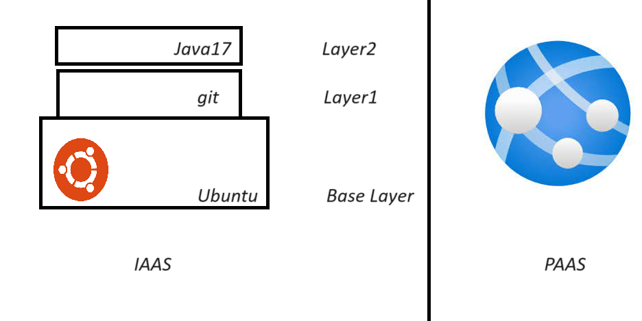
IAAS vs PAAS solution

Slide 4
IAAS Example
Virtual machine
In IAAS offerings cloud provider will give you VM, and you can install whatever software you want.

Slide 5
PAAS Example
App services
Here, Cloud provider will provide platform to run your application, and they manage all the things

